Slide 1
Nutrition for life
Learning to eat healthy

Slide 2
What is nutrition?
Nutrition: the science of food and the ways the body uses food.
ALSO….
Nutrition: the study of how and why we make food choices.

Slide 3
What are nutrients?
Nutrients: things in food that provide energy or help make body tissue.
Necessary for Life! Necessary for Growth!
SIX CLASSES OF NUTRIENTS!

Slide 4
Six classes of nutrients
Carbohydrates
Fats
Proteins
Vitamins
Minerals
Water

Slide 5
Carbohydrates
Carbs: energy nutrients that include sugars, starches, and fiber.
2 Basic Types of Carbs
SIMPLE: single/double sugar molecules
COMPLEX: many sugar molecules that are linked together.

Slide 6
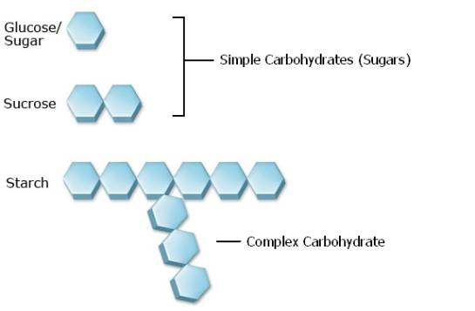
Simple vs. Complex Carbs

Slide 7
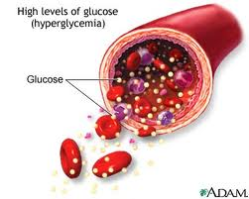
Simple Carbs
Simplest = Sugars
-OSE: suffix for sugar
COMMON SINGLE SUGARS:
1.) Glucose: single unit of sugar (most important).
2.) Fructose: found in fruit & honey.
Glucose circulates through the
body to provide energy for cells.

Slide 8
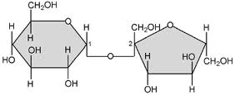
Other Sugars
Double Sugar = made of two single sugar molecules.
COMMON DOUBLE SUGARS:
1.) Lactose: found in dairy products.
2.) Sucrose: found in candies & baked goods.

Slide 9
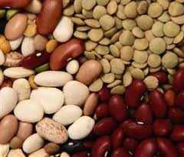
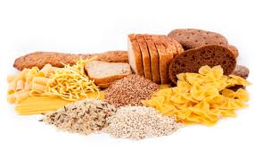
Complex Carbs
Starches: many sugar molecules that are linked together.
Must be broken down into simple sugars to use for energy.
Where to find starches?
Starchy Vegetables (potatoes)
Legumes (beans & peas)
Grains (rice, corn wheat)

Slide 10
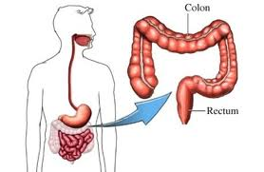
Complex Carbs
Fiber: provides little energy, cannot be digested.
Soluble Fiber Insoluble Fiber
- dissolve in water - do not dissolve in water
- hold water - do not hold water
- add volume - add bulk
- help prevent heart disease - help prevent colon cancer
- help prevent colon cancer

Slide 11
Fats
Fat is required for good health!
REQUIRED FOR PROPER HUMAN FUNCTION!
Problems With Fat
1.) Eating too Much!
2.) Eating the Wrong Kinds!

Slide 12
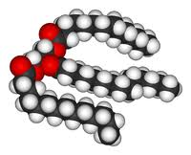
What is FAT?
Fat: fatty or oily substance that does not dissolve in water (classified: lipids )
FAT = 3 fatty acids and 1 glycerol
Fatty Acids: chain of carbon atoms (single bonds)
Glycerol: simple compound.
FAT or AKA: Triglycerides

Slide 13
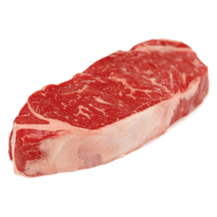
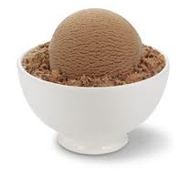
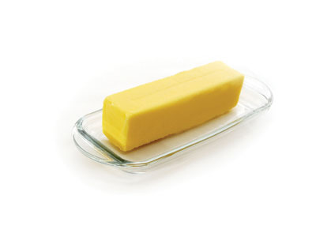
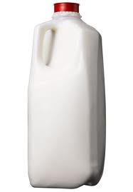
Types of fat - saturated
Where do they come from?
Animal Foods Milk
Meat Butter Ice Cream
What are they?
Fatty acids (carbon atoms connected to as many
hydrogen bonds as possible – the bonds are maxed out).
NEXT SLIDE

Slide 14
Saturated fats

Slide 15
What’s the problem?
More Bonds to Break
Harder to Use for Energy
Not Used, Stored on Body
Weight Gain & High Cholesterol
Heart Disease, Obesity, & More!

Slide 16
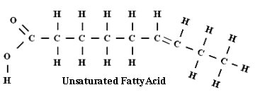
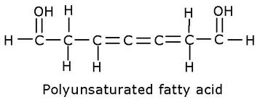
Types of fat - unsaturated
Where do they come from?
Plant Sources!
What are they?
Fatty acids (carbon atoms with one or more
double bonds between each other–
preventing hydrogen from bonding).
Mono
(Single Double Bound)
(2 or More Double Bounds)

Slide 17
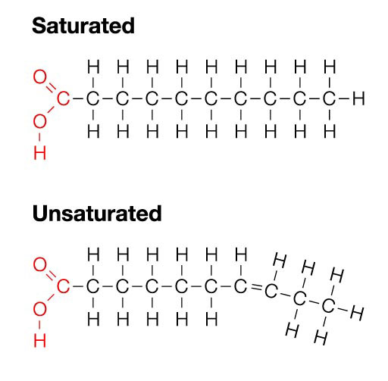
Saturated vs. unsaturated

Slide 18
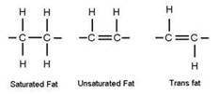
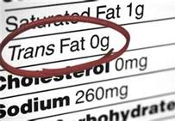
Types of fat - unsaturated
Trans Fats: artificially processed, hydrogen added to fats.
Confusion in the body!
Stored as Fat!
Bad!

Slide 19
Types of fat - cholesterol
Cholesterol: lipids in the body that help/hurt body function and health.
Where is it found?
Only in animal tissue.

Slide 20
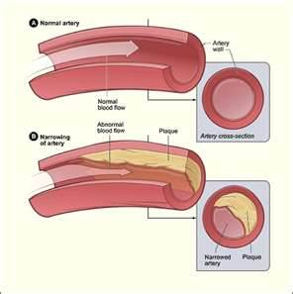
Types of fat - cholesterol
BAD CHOLESTEROL
LDL (low density lipoprotein): brings cholesterol to the cells.
Levels of LDL Plaque forms on the wall of blood vessels

Slide 21
Types of fat - cholesterol
GOOD CHOLESTEROL
HDL (high density lipoprotein): takes cholesterol back to liver, where it is removed.
HDL → linked to a reduced risk of developing heart disease.

Slide 22
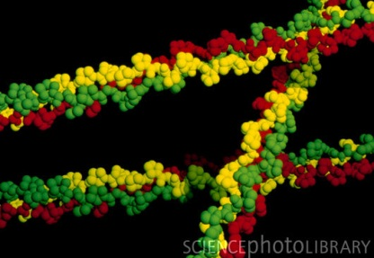
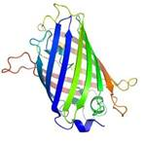
What is protein?
Why do I need protein?
Protein helps build new cells and repair old cells in the body
(ex: muscle, skin, hair, nails, etc.)
What are they made of?
Chain of amino acids (looks like a necklace)
20 different amino acids make different types of protein.

Slide 23
Different proteins
Nonessential Amino Acids: 11/20 amino acids are naturally made in the body.
Essential Amino Acids: 9/20 amino acids are not made in the body.
(must eat foods with these proteins)
NOTE: If amino acid is missing, the body can make non essential amino acids. However, if the missing amino acid is an essential acid, it can not be made.

Slide 24
Different proteins
Complete Proteins: foods that contain all essential amino acids.
(most animal products contain all amino acids)
Incomplete Proteins: foods that are lacking essential amino acids.
(legumes, grains, vegetables lack all amino acids)

Slide 25
Healthy Diet - proteins
Eating High Amounts of Animal Products to Get Amino Acids
High calories
Saturated Fats
Cholesterol
Disease, Etc.
Not Eating Animal Products
Lack amino acids.
Eating a wide variety in order to find all amino acids (educated).
What is the best solution?
(next slide)

Slide 26
assignment
3-Day Food Plan
Description: The plan for this assignment is to get an accurate reading of your current eating habits. You need to track everything you eat and drink for three full days.
DUE DATE: 3 full days from now!
You are not graded on habits!
Graded on honesty, detail and full completion!
Sample: Click Here

Slide 27
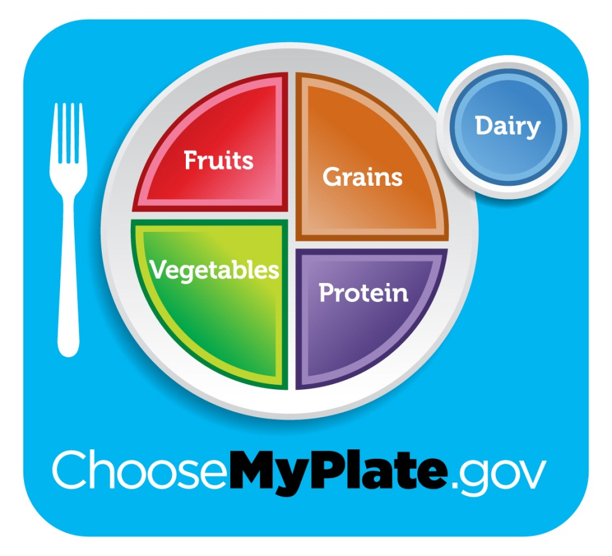
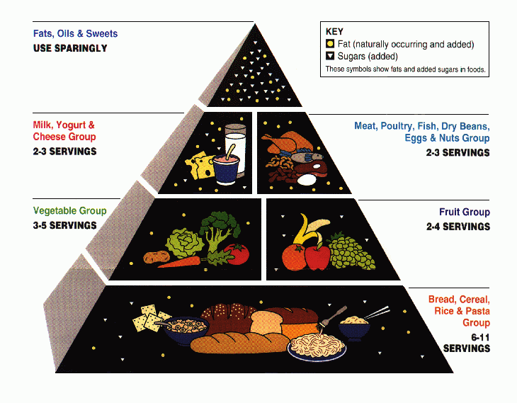
My plate

Slide 28
My plate
MyPlate illustrates the five food groups that are the building blocks
for a healthy diet using a familiar image — a place setting for a meal.
Is my plate complete?
What goes on my plate?
Is there variety?
How much of each food goes on my plate?

Slide 29
Important items going forward
RDAs (recommended daily allowances): recommended nutrient intakes that will meet almost all healthy people.
CLICK HERE

Slide 30
myplate
Individual Meal vs. Daily Intake
Individual Meal Goal: Aim to complete your plate each meal!
Daily Intake Goal: While looking at each meal is a great start, make sure to keep your daily recommendations in mind!

Slide 31
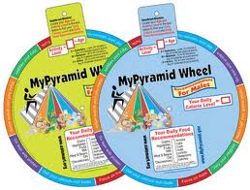
Individual recommendations
Individual Meal vs. Daily Intake
Recommendations -- Wheel Activity
Write down the following:
1.) Name
2.) Age
3.) Activity Level
4.) Daily Calorie Level
5.) Individual Food Groups Recommendations

Slide 32
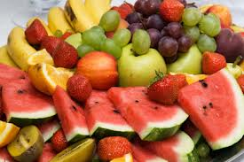
Fruits
Meal Goal: aim for ¼ of your plate to be fruits.
Do I have to eat them a certain way?
- Fresh - Canned
- Frozen - Dried
- Whole - Cut-up
- Pureed

Slide 33
Fruits – Recommended daily allowances
Girls |  | 9-13 years old |  | 1 ½ cups
 |  | 14-18 years old |  | 1 ½ cups
Boys |  | 9-13 years old |  | 1 ½ cups
 |  | 14-18 years old |  | 2 cups
What is a cup?
(Click Here)

Slide 34
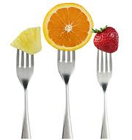
Fruit – Health benefits
Eating a diet rich in fruits may reduce risk for heart disease, including heart attack and stroke.
Eating a diet rich in some fruits may protect
against certain types of cancers.
Diets rich in foods containing fiber, such as some
fruits, may reduce the risk of heart disease,
obesity, and type 2 diabetes.

Slide 35
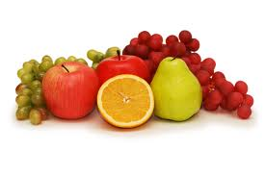
Fruit – Health benefits
Eating vegetables and fruits rich in potassium may lower blood pressure, and may also reduce the risk of developing kidney stones and help to decrease bone loss.
Fruits that are lower in calories per cup instead of some other higher-calorie food may be useful in helping to lower calorie intake.

Slide 36
Fruit - nutrients
Most fruits are naturally low in fat, sodium, and calories.
No cholesterol.
Fruits are sources of many essential nutrients that are under consumed, including potassium, dietary fiber, vitamin C, and folate (folic acid).

Slide 37
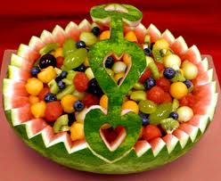
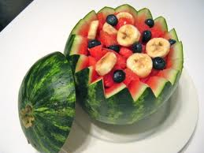
Fruit - nutrients
Potassium helps maintain healthy blood pressure.
Fruit sources: bananas, prunes and prune juice, dried peaches and apricots, cantaloupe, honeydew melon, and orange juice.
Dietary fiber from fruits helps reduce cholesterol levels. Fiber-containing foods such as fruit help provide a feeling of fullness with fewer calories. Whole or cut-up fruits are sources of dietary fiber; fruit juices contain little or no fiber.

Slide 38
Fruit - nutrients
Vitamin C is important for growth and repair of all body tissues, helps heal cuts and wounds, and keeps teeth and gums healthy.
Folate (folic acid) helps the body form red blood cells.
Women of childbearing age who may become
pregnant should consume adequate folate from foods.

Slide 39
Easy Tips to eating fruits!
In General:
Keep a bowl of whole fruit on the table, counter, or in the refrigerator.
Refrigerate cut-up fruit to store for later.
Buy fruits in season! (COST)
Find fruit that you enjoy.
OTHER TIPS?

Slide 40
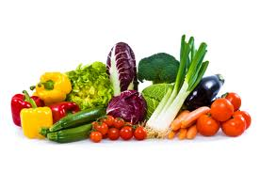
Vegetables
Meal Goal: aim for ¼ of your plate to be vegetables.
Do I have to eat them a certain way?
- 100% Juice - Canned
- Frozen - Dried/Dehydrated
- Whole - Cut-up
- Fresh - Raw
- Mashed

Slide 41
Vegetables– Recommended daily allowances
Girls |  | 9-13 years old |  | 2 cups**
 |  | 14-18 years old |  | 2½ cups**
Boys |  | 9-13 years old |  | 2½ cups**
 |  | 14-18 years old |  | 3 cups**
What is a cup?
(click here)

Slide 42
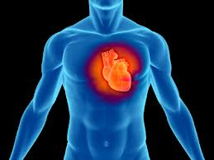
Vegetables – Health benefits
Reduce the risk for heart disease, including heart attack and stroke.
Protect against certain types of cancers.
Diets rich in foods may reduce the risk of heart disease, obesity, and type 2 diabetes.

Slide 43
Vegetables – Health benefits
Eating vegetables rich in potassium may lower blood pressure, and may also reduce the risk of developing kidney stones and help to decrease bone loss.
Eating vegetables that are lower in calories per cup instead of some other higher-calorie food may be useful in helping to lower calorie intake.

Slide 44
Vegetables - nutrients
Most vegetables are naturally low in fat and calories. No cholesterol.
Vegetables are important sources of many nutrients!
Vitamin A keeps eyes and skin healthy and helps to
protect against infections.

Slide 45
Vegetables - nutrients
Potassium may help to maintain healthy blood pressure.
Dietary fiber from vegetables helps reduce blood cholesterol levels.
Folate (folic acid) helps the body form red blood cells.
Vitamin C helps heal cuts and wounds and keeps teeth and gums healthy.

Slide 46
Easy Tips to eating vegetables!
Buy in season! They cost less and are likely to be at their peak flavor.
Buy vegetables that are easy to prepare. Buy packages of veggies such as baby carrots or celery sticks for quick snacks.
Use a microwave to quickly “zap” vegetables. White or sweet potatoes can be baked quickly this way.
Vary your veggie choices to keep meals interesting.
Try crunchy vegetables, raw or lightly steamed.

Slide 47
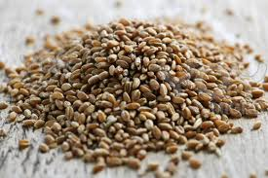
grains
Meal Goal: aim for ¼ of your plate to be grains.
Aim for ½ of grains to be whole grains.
There are (2) subgroups of grains:
Whole Grains: contains the entire grain kernel.
Refined Grains: processed to remove parts of the kernel.

Slide 48
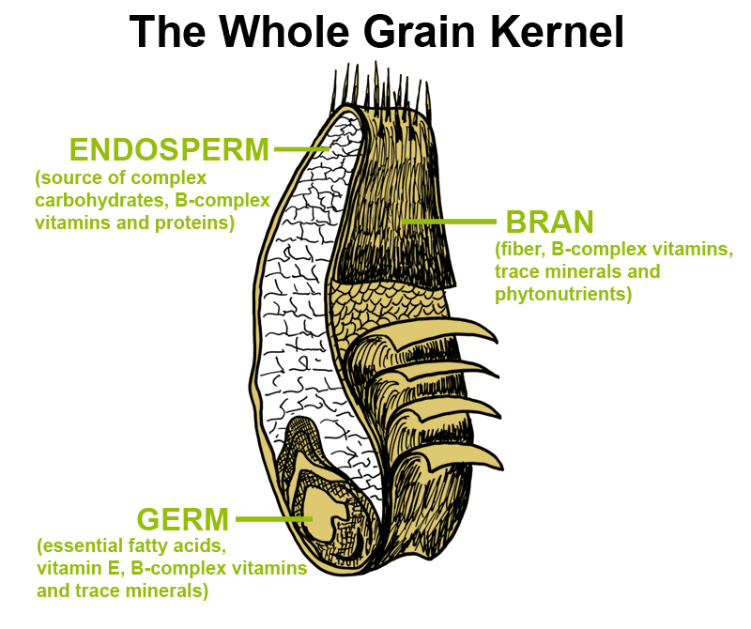

Slide 49
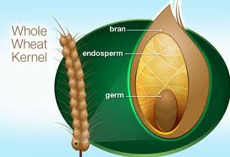
Whole Grains
What are Whole Grains?
Contains the entire kernel
(bran, endosperm, and germ).
Why are they good?
Fiber!
Where can I find whole grains?
- whole-wheat flour
- oatmeal
- whole cornmeal
- brown rice
- check food packaging!

Slide 50
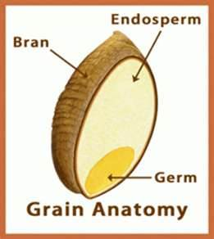
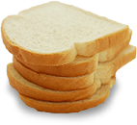
Refined grains
What are Whole Grains?
Bran & Germ Removed to
Improve Texture and Shelf Life
Why are they bad?
Most fiber, iron, & B vitamins removed.
(some iron and vitamins added back).
Where can I find whole grains?
White flour
White Rice
White Bread
Much, Much More!

Slide 51
grains – Recommended daily allowances
Girls |  | 9-13 years old |  | 5 ounce equivalents** |  | 3 ounce equivalents**
 |  | 14-18 years old |  | 6 ounce equivalents** |  | 3 ounce equivalents**
Boys |  | 9-13 years old |  | 6 ounce equivalents** |  | 3 ounce equivalents**
 |  | 14-18 years old |  | 8 ounce equivalents** |  | 4 ounce equivalents**
What is an Ounce?
(Click Here)

Slide 52
Grains – Health benefits
Reduce the risk of heart disease, colon cancer, cancer of the intestines, & more!
Consuming foods containing fiber, such as whole grains, may reduce constipation.
Help with weight management.
Eating grain products fortified with folate before and during pregnancy helps prevent defects during fetal development.

Slide 53
grains - nutrients
Important sources of many nutrients, including fiber, several B vitamins, and minerals.
Help reduce blood cholesterol levels and may lower risk of heart disease, obesity, and type 2 diabetes.
The feeling of being full with fewer calories!
The B vitamins thiamin, riboflavin, and niacin play a key role in metabolism.

Slide 54
grains - nutrients
Folate (folic acid), another B vitamin, helps the body form red blood cells.
Iron is used to carry oxygen in the blood. Many teenage girls and women in their childbearing years have iron-deficiency anemia.
Sources of magnesium and selenium. Magnesium is a mineral used in building bones and releasing energy from muscles.
Important for a healthy immune system.

Slide 55
Easy Tips to eating grains!
Substitute a whole-grain product for a refined product. It’s important to substitute, not add.
For a change, try brown rice or whole-wheat pasta.
Experiment by substituting whole wheat or oat flour for up to half of the flour in pancake, waffle, muffin or other flour-based recipes.
Use whole-grain bread or cracker crumbs in meatloaf.

Slide 56
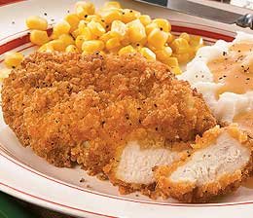
Easy Tips to eating grains!
Try rolled oats or a crushed, unsweetened whole grain cereal as breading for baked chicken, fish, veal cutlets, or eggplant parmesan.
Try a whole grain ready-to-eat cereal as
croutons in salad or in place of crackers
with soup.
Freeze leftover cooked brown rice, bulgur,
or barley. Heat and serve it later as a quick
side dish.

Slide 57
Protein foods
Meal Goal: aim for ¼ of your plate to be protein.
** Refer to earlier sides on protein **

Slide 58
protein – Recommended daily allowances
Girls |  | 9-13 years old |  | 5 ounce equivalents**
 |  | 14-18 years old |  | 5 ounce equivalents**
Boys |  | 9-13 years old |  | 5 ounce equivalents**
 |  | 14-18 years old |  | 6 ½ ounce equivalents**
What is an ounce?
(click here)

Slide 59
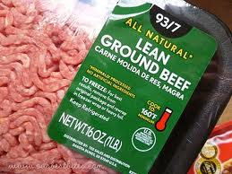
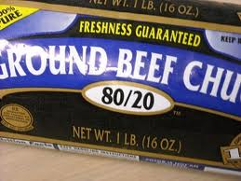
Easy Tips to eating protein!
The leanest beef cuts include round steaks and roasts (eye of round, top round, bottom round, round tip), top loin, top sirloin, and chuck shoulder.
The leanest pork choices include pork loin, tenderloin, center loin, and ham.
Choose extra lean ground beef. The label should say at least “90% lean.”

Slide 60
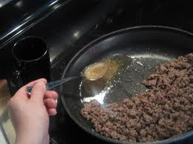
Easy Tips to eating protein!
Boneless & skinless!
Choose lean turkey, roast beef, ham, or low-fat
lunch meats for sandwiches.
Trim away all of the visible fat from meats and
poultry before cooking.
Drain off any fat that appears during cooking.
Skip or limit the breading on meat, poultry, or fish.
Choose and prepare foods without high fat
sauces or gravies.

Slide 61
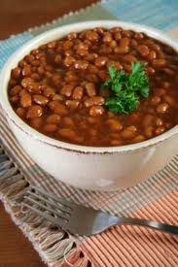
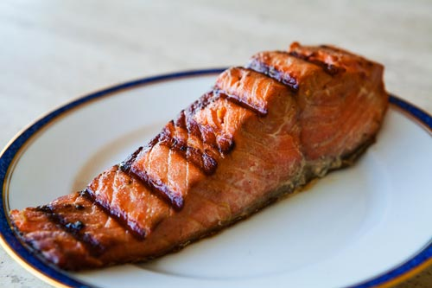
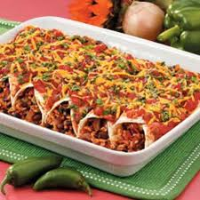
Easy Tips to eating protein!
Choose unsalted nuts as a snack, on salads, or in main dishes. Use nuts to replace meat or poultry, not in addition to these items.
Look for seafood rich in omega-3 fatty acids Some ideas are:
Salmon steak or filet
Grilled or baked trout
Choose beans, peas, or soy products as a main dish or part of a meal often. Some choices are:
Chili with kidney or pinto beans
Split pea, white bean soups
Baked beans
Black bean enchiladas
Rice and beans

Slide 62
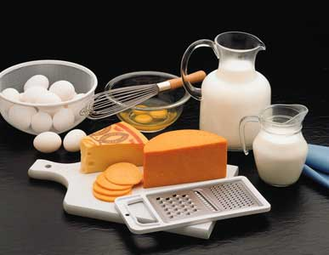
Dairy
Meal Goal: aim for some sort of dairy with your meal.
What is considered dairy?
Foods that have been made from milk
that retain their calcium content.
What is not considered?
Foods that do not retain calcium.
(cream cheese, cream, butter, etc.)

Slide 63
dairy – Recommended daily allowances
Girls | 9-13 years old | 3 cups
 | 14-18 years old | 3 cups
Boys | 9-13 years old | 3 cups
 | 14-18 years old | 3 cups
What is considered a cup?
(click here)

Slide 64
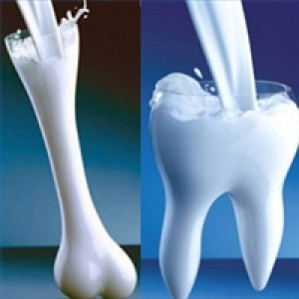
dairy – Health benefits
Linked to improved bone health, and may reduce the risk of osteoporosis.
Especially important to bone health during childhood and adolescence, when bone mass is being built.
Reduced risk of cardiovascular disease and type 2 diabetes, and with lower blood pressure in adults.

Slide 65
dairy - nutrients
Calcium is used for building bones and teeth and in maintaining bone mass. Dairy products are the primary source of calcium in American diets.
Diets rich in potassium may help to maintain healthy blood pressure.
Vitamin D functions in the body to maintain proper levels of calcium and phosphorous, thereby helping to build and maintain bones.
Milk products that are consumed in their low-fat or fat-free forms provide little or no solid fat.

Slide 66
Easy Tips to eating dairy!
Include milk as a beverage at meals. Choose fat-free or low-fat milk.
If you usually drink whole milk, switch gradually to fat-free milk, to lower saturated fat and calories. Try reduced fat (2%), then low-fat (1%), and finally fat-free (skim).
If you drink cappuccinos or lattes — ask for them with fat-free (skim) milk.
Add fat-free or low-fat milk instead of water to oatmeal and hot cereals.

Slide 67
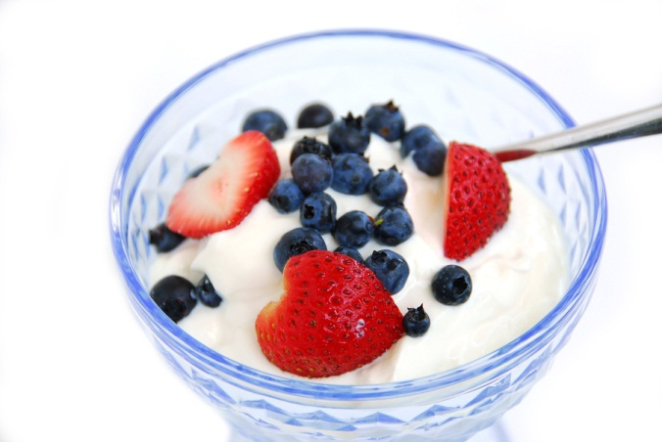
Easy Tips to eating dairy!
Have fat-free or low-fat yogurt as a snack.
Make fruit-yogurt smoothies in the blender (extra credit).
Top cut-up fruit with flavored yogurt for a quick dessert.
Top casseroles, soups, stews, or vegetables with shredded reduced-fat or low-fat cheese.

Slide 68
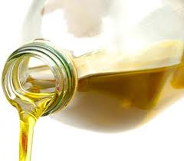
oils
What are oils?
Oils are fats that are liquid at room temperature.
Not a food group.
Some contain essential nutrients, including
essential fatty acids.
Some Common Used Oils
canola oil corn oil
cottonseed oil olive oil
soybean oil sunflower oil

Slide 69
Oils vs. other fats
All fats and oils are a mixture of saturated
fatty acids and unsaturated fatty acids.
Solid fats contain more saturated fats
and/or trans fats than oils.

Slide 70
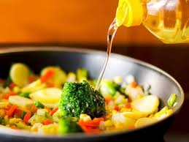
Oils
Why eat oils?
Some have great essential nutrients.
Do I need to be careful?
Most prepared food have more than enough oils added in the cooking process. You do not need to seek out oil.

Slide 71
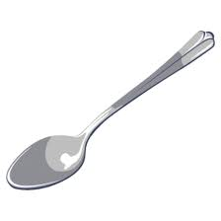
oils– Recommended daily allowances
Girls |  | 9-13 years old |  | 5 teaspoons
 |  | 14-18 years old |  | 5 teaspoons
Boys |  | 9-13 years old |  | 5 teaspoons
 |  | 14-18 years old |  | 6 teaspoons

Slide 72
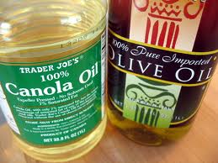
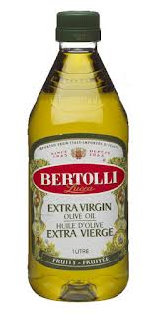
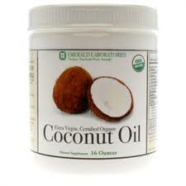
What are the best oils?
Extra-Virgin Olive
Canola
Soybean
Palm
Coconut
Almond
Grape Seed

Slide 73
Do not ignore Food Labels
Read the Label Video
Click Here (0:31)
How does reading food labels
help you eat better?

Slide 74
Extra Credit Opportunity
MyPlate Video Challenge
The U.S. Department of Agriculture (USDA) MyPlate Fruits and Veggies Video Challenge invites you to create short videos showing how you’re adding fruits and vegetables to your diet without spending a lot of money or effort. We encourage you to create videos that are inspiring and instructive — show a healthy tip that has worked for you and that you think can work for other people. Videos must be submitted in one of the following categories:
Category #1: Tips for kids
Category #2: Tips when eating at home
Category #3 Tips when eating away from home
CONTEST CLOSED
GIVE DUE DATE
View Previous Winners
(click here)

Slide 75
Reading Labels
Handout
1.) Sample Label
2.) One Food Label
*** We will work through the worksheet together.
*** DO NOT work ahead!
*** Fill in the blanks as we go. CLICK HERE

Slide 76
Sample Label – Section #1
Serving Size & Servings Per Container
- Nutritional facts are per serving.
- Most packages have more than one serving.
- Serving size help calculate/compare foods.
- It is okay to eat more or less of a serving, but you must calculate that in for your recommended daily amounts for the remainder of the day.

Slide 77
Sample Label – Section #2
Check Calories
- Find your calories on your label.
- This is calories per serving, not per package.
Stand up if you think you have
a food that is high in calories.
Multiply Calories by Servings Eaten

Slide 78
Sample Label – Section #3
Limit These Nutrients
Why should you limit fat, cholesterol, and sodium?
(next slide)

Slide 79
Sample Label – Section #3
Limit These Nutrients
Too much fat, cholesterol, and sodium can cause:
heart disease high blood pressure
stroke diabetes
cancer obesity

Slide 80
Sample Label – Section #4
Get Enough of These Nutrients
- Your body needs over 40 nutrients to be healthy.
What foods are good for…?
(a) Vitamin A (b) Vitamin C
(c) Calcium (d) Iron
Homework: Research 3 Foods for the nutrients listed above.
List the foods, how much of each, and how it is beneficial to your body.

Slide 81
Sample Label – Section #5
Daily Value (DV)
- Determine if you are closer to a 2,000 calorie diet or a 2,500 calorie diet.
- Circle the column that you are closer to. This will help you understand your recommended daily values.

Slide 82
Sample Label – Section #6
% Daily Value
- Percentages are for a 2,000 calorie diet.
- Not everyone is on a 2,000 calorie diet.
- Many of you will have %’s lower or higher.
Would a person with a calorie diet higher than 2,000 have lower or higher percentages shown on the label? (next slide)

Slide 83
Sample Label – Section #6
+ 2,000 Calorie Diet = Lower %
- 2,000 Calorie Diet = Higher %

Slide 84
Sample Label – Section #7
Ingredients
- Ingredients are listed in descending order by weight (most to least).
- Be careful of ingredients (allergies, different names).

Slide 85
Food Labels
Video
The Food Label & You (28:48)
CLICK HERE

Slide 86
Myths vs. Facts
Myth: statement that may by widely accepted, but is not true.
Fact: a statement that is true.
Lets explore some nutrition statements…

Slide 87
Nutrition statements
(1) It doesn’t matter what you eat as long as you are eating from all 5 food groups.
(2) Certain foods make you gain weight easier than others.
(3) The main food group most people need to concentrate on eating more of is the Meat and Beans group.
(4) Only about 40% of your total calories should come from fats that you eat.
(5) Wash your hands for 10 seconds before eating or cooking.
(6) If you quit salting your food, your diet will be low in sodium.
(7) Alcohol contains nutrients not found in food.
Homework: Research your statement and decide if it is a myth or fact. Provide cited research.

Slide 88
Myth vs. fact
(1) It doesn’t matter what you eat as long as you are eating from all 5 food groups.
TRUTH:
Eating from all 5 food groups is a start!
Eat from a variety of foods within each food group (different nutrients).
Eat the # of calories that you burn through daily activity.

Slide 89
Myth vs. fact
(2) Certain foods make you gain weight easier than others.
TRUTH:
A calorie is a calorie!
Some foods do have more calories than others.
Eating too many total calories is what makes you gain weight, not the food itself.
3,500 Calories = 1 Pound

Slide 90
Myth vs. fact
(3) The main food group most people need to concentrate on eating more of is the Meat and Beans group.
TRUTH:
Emphasis is on eating more fruits, vegetables, whole grains, and fat free or low fat milk products.
Most Americans are getting more than enough protein (meats and beans).

Slide 91
Myth vs. fact
(4) Only about 40% of your total calories should come from fats that you eat.
TRUTH:
25% - 35% of calories should come from fat.
Most fat should be polyunsaturated and monounsaturated (fish, nuts, oils).
Must limit amounts of saturated fats (animal).
Eliminate trans fats (processed and packaged foods).

Slide 92
Myth vs. fact
(5) Wash your hands for 10 seconds before eating or cooking.
TRUTH:
76,000,000 Americans get “Food Poisoning” per year
20 seconds (30 better)
Soap & Warm/Hot Water
Tops, palms, between fingers, nails, up the wrist
Dry with a clean towel & don’t recontamination!

Slide 93
Myth vs. fact
(6) If you quit salting your food, your diet will be low in sodium.
TRUTH:
Most eat more salt than they need!
Not salting = good start!
75% of sodium intake comes from packaged/processed foods.
Best = Read labels, limit those foods.

Slide 94
Myth vs. fact
(7) Alcohol contains nutrients not found in food.
TRUTH:
High Calories / No Nutrients.
Harmful when consumed in excess.
Teens should not drink at all.
Theorized benefits pertain to middle-aged adults.

Slide 95
Extra Credit Opportunity
Smoothie Challenge
Description: Create an original recipe for a smoothie.
Requirements: typed recipe, small paper cups, ingredients brought to class
Bring enough for each student to have a small sample!
Winner will receive double the extra credit!
GIVE DUE DATE

Slide 96
Healthy eating – ultimate goal

Slide 97
Dangerous of Weight Management

Slide 98
Super Size Me vs. Fat Head
vs.

Slide 99
assignment
Super Size Me vs. Fat Head
Handout Essay Requirements

